Slide 1

POLYNOMIAL FUNCTIONS

Slide 2
REMAINDER THEOREM AND FACTOR THEOREM

Slide 3
REMAINDER THEOREM AND FACTOR THEOREM
If P is a polynomial function, then the values of x for which
P(x) is equal to 0 are called the zeros of P.
For instance, –1 is a zero of P(x) = 2x³ – x + 1 because
P(–1) = 2(–1)³ – (–1) + 1
= –2 + 1 + 1
= 0

Slide 4
DIVISION OF POLYNOMIALS

Slide 5
Division of Polynomials
To divide a polynomial by a monomial, divide each term of
the polynomial by the monomial. For instance,
To divide a polynomial by a binomial, we use a method
similar to that used to divide natural numbers.
Divide each term in the numerator by the denominator.
Simplify.

Slide 6
Division of Polynomials
For instance, consider (6x3 – 16x2 + 23x – 5) ÷ (3x – 2).
Think .
Multiply: 2x²(3x – 2) = 6x³ – 4x²
Subtract and bring down the next term, 23x.

Slide 7
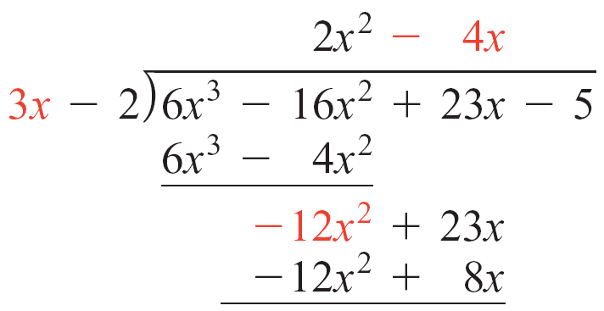
Division of Polynomials
Think .
Multiply: –4x(3x – 2) =
–12x² + 8x
Subtract and bring down the next term,
–5.

Slide 8
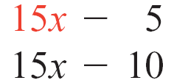
Division of Polynomials
Quotient
Divisor
Dividend
Think .
Multiply: 5(3x – 2) = 15x – 10.
Subtract to produce the remainder, 5.

Slide 9
Division of Polynomials
The division process ends when the expression in the
bottom row is of lesser degree than the divisor.
The expression in the bottom row is the remainder, and
the polynomial in the top row is the quotient.
Thus (6x³ – 16x² + 23x – 5) ÷ (3x – 2) = 2x² – 4x + 5
with a remainder of 5.

Slide 10
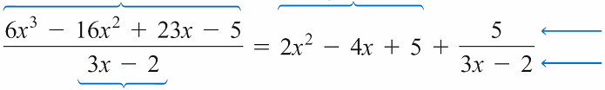
Division of Polynomials
Although there is nothing wrong with writing the answer as
we did, it is more common to write the answer as the
quotient plus the remainder divided by the divisor.
Using this method, we write
Dividend
Quotient
Remainder
Divisor
Divisor

Slide 11
Division of Polynomials
In every division, the dividend is equal to the product of the
divisor and quotient, plus the remainder. That is,
6x³ – 16x² + 23x – 5 = (3x – 2)  (2x² – 4x + 5) + 5
The preceding polynomial division concepts are summarized by the following theorem.
Division Algorithm for Polynomials
Let P(x) and D(x) be polynomials, with D(x) of lower degree than P(x) and D(x) of degree 1 or more.
=
+
Dividend
Divisor

Quotient
Remainder

Slide 12
Division of Polynomials
Then there exist unique polynomials Q(x) and R(x) such
that
P(x) = D(x)  Q(x) + R(x)
where R(x) is either 0 or of degree less than the degree of D(x). The polynomial P(x) is called the dividend, D(x) is the divisor, Q(x) is the quotient, and R(x) is the remainder.
Before dividing polynomials, make sure that each polynomial is written in descending order.

Slide 13
Division of Polynomials
In some cases, it is helpful to insert a 0 in the dividend for a
missing term (one whose coefficient is 0) so that like terms
align in the same column. This is demonstrated in
Example 1.

Slide 14
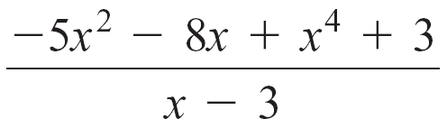
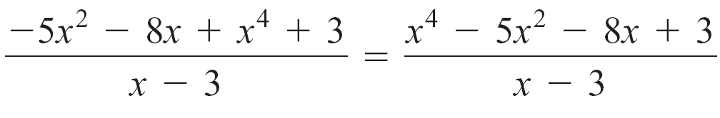
Example 1 – Divide Polynomials
Divide:
Solution:
Write the numerator in descending order. Then divide.

Slide 15
Example 1 – Solution
cont’d
Thus
Inserting 0x³ for the missing term helps align
like terms in the same column.

Slide 16
SYNTHETIC DIVISION

Slide 17
Synthetic Division
A procedure called synthetic division can expedite the
division process.
To apply the synthetic division procedure, the divisor must be a polynomial of the form x – c, where c is a constant.
In the synthetic division procedure, the variables that occur in the polynomials are not listed.

Slide 18
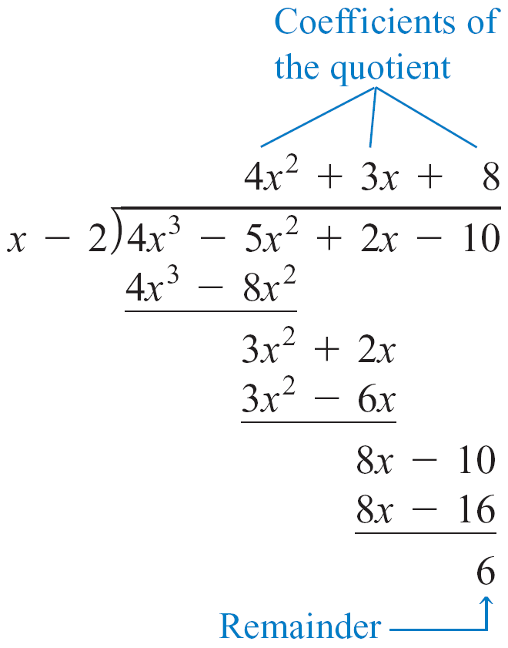
To understand how synthetic division is performed, examine the following long division on the left and the related synthetic division on the right.
Long Division Synthetic Division

Slide 19
Synthetic Division
In the long division, the dividend is 4x³ – 5x² + 2x – 10 and
the divisor is x – 2.
Because the divisor is of the form x – c, with c = 2, the division can be performed by the synthetic division procedure. Observe that in the above synthetic division:
1. The constant c is listed as the first number in the first row, followed by the coefficients of the dividend.
2. The first number in the third row is the leading coefficient of the dividend.

Slide 20
Synthetic Division
3. Each number in the second row is determined by
computing the product of c and the number in the third row of the preceding column.
4. Each of the numbers in the third row, other than the first number, is determined by adding the numbers directly above it.
The following explanation illustrates the steps used to find the quotient and remainder of (2x³ – 8x + 7) ÷ (x + 3) using synthetic division.

Slide 21
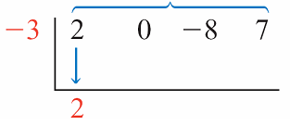
Synthetic Division
The divisor x + 3 is written in x – c form as x – (–3), which indicates that c = –3. The dividend 2x³ – 8x + 7 is missing an x² term.
If we insert 0x² for the missing term, the dividend becomes 2x³ + 0x² – 8x + 7.
Coefficients of the dividend
Write the constant c, –3, followed by the coefficients of the dividend. Bring down the first coefficient in the first row, 2, as the first number of the third row.

Slide 22
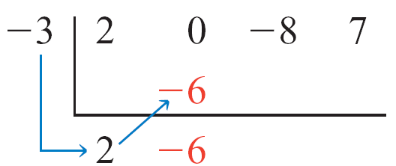
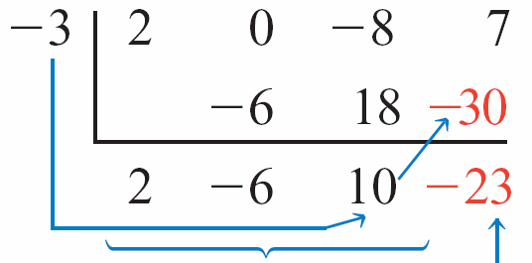

Synthetic Division
Multiply c times the first number in the third row, 2, to produce the first number of the second row, –6. Add the 0 and the –6 to produce the next number of the third row, –6.
Multiply c times the second number in the third row, –6, to produce the next number of the second row, 18. Add the –8 and the 18 to produce the next number of the third row, 10.
Multiply c times the third number in the third row, 10, to produce the next number of the second row, –30. Add the 7 and the –30 to produce the last number of the third row, –23.
Coefficients of
the quotient
Remainder

Slide 23
Synthetic Division
The last number in the bottom row, –23, is the remainder.
The other numbers in the bottom row are the coefficients of
the quotient.
The quotient of a synthetic division always has a degree that is one less than the degree of the dividend. Thus the quotient in this example is 2x² – 6x + 10.

Slide 24
Synthetic Division
The results of the synthetic division can be expressed in fractional form as
or as
In Example 2, we illustrate the compact form of synthetic division, obtained by condensing the process explained here.

Slide 25
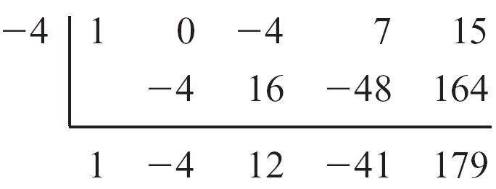
Example 2 – Use Synthetic Division to Divide Polynomials
Use synthetic division to divide x⁴ – 4x² + 7x + 15 by x + 4.
Solution:
Because the divisor is x + 4, we perform synthetic division with c = –4.
The quotient is x³ – 4x² + 12x – 41, and the remainder is 179.

Slide 26
REMAINDER THEOREM

Slide 27
Remainder Theorem
The following theorem shows that synthetic division can be used to determine the value P(c) for a given polynomial P(x) and constant c.
Remainder Theorem
If a polynomial P(x) is divided by x – c, then the remainder equals P(c).
In Example 3, we use synthetic division and the Remainder Theorem to evaluate a polynomial function.

Slide 28
Example 3 – Use the Remainder Theorem to Evaluate a Polynomial Function
Let P(x) = 2x³ + 3x² + 2x – 2. Use the Remainder Theorem
to find P(c) for c = –2 and c = .
Solution:
Perform synthetic division with c = –2 and c = and examine the remainders.
The remainder is –10. Therefore, P(–2) = –10.

Slide 29
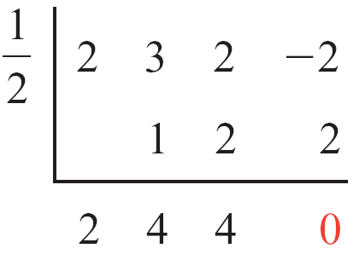
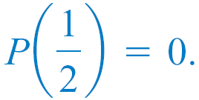
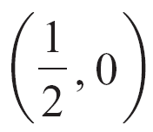
Example 3 – Solution
cont’d
The remainder is 0. Therefore,
The points (–2, –10) and
are on the graph of P.
P(x) = 2x³ + 3x² + 2x – 2

Slide 30
Remainder Theorem
Using the Remainder Theorem to evaluate a polynomial
function is often faster than evaluating the polynomial
function by direct substitution.
For instance, evaluating
P(x) = x⁵ – 10x⁴ + 35x³ – 50x² + 24x by substituting 7 for x requires the following work.
P(7) = (7)⁵ – 10(7)⁴ + 35(7)³ – 50(7)² + 24(7)
= 16,807 – 10(2401) + 35(343) – 50(49) + 24(7)
= 16,807 – 24,010 + 12,005 – 2450 + 168
= 2520

Slide 31
Remainder Theorem
Using the Remainder Theorem to evaluate P(7) requires only the following work.

Slide 32
Factor Theorem

Slide 33
Factor Theorem
Note from Example 3 that . Recall that is a zero
of P because P(x) = 0 when x = .
The following theorem shows the important relationship between a zero of a given polynomial function and a factor of the polynomial.
Factor Theorem
A polynomial P(x) has a factor (x – c) if and only if P(c) = 0. That is, (x – c) is a factor of P(x) if and only if c is a zero of P.

Slide 34
Example 4 – Apply the Factor Theorem
Use synthetic division and the Factor Theorem to determine whether (x + 5) or (x – 2) is a factor of
P(x) = x⁴ + x³ – 21x² – x + 20.
Solution:
The remainder of 0 indicates that (x + 5) is a factor of P(x).

Slide 35
Example 4 – Solution
cont’d
The remainder of –42 indicates that (x – 2) is not a factor of
P(x).

Slide 36
Factor Theorem
Here is a summary of the important role played by the remainder in the division of a polynomial by (x – c).
Remainder of a Polynomial Division
In the division of the polynomial P(x) by (x – c), the remainder is
equal to P(c)
0 if and only if (x – c) is a factor of P(x)
0 if and only if c is a zero of P.
If c is a real number, then the remainder of P(x) ÷ (x – c)
is 0 if and only if (c, 0) is an x-intercept of the graph of P.

Slide 37
REDUCED POLYNOMIALS

Slide 38
Reduced Polynomials
In Example 4 we showed that (x + 5) is a factor of
P(x) = x⁴ + x³ – 21x² – x + 20 and that the quotient of P(x) divided by (x + 5) is x³ – 4x² – x + 4. Thus
P(x) = (x + 5)(x³ – 4x² – x + 4)
The quotient x³ – 4x² – x + 4 is called a reduced polynomial, or a depressed polynomial, of P(x) because it is a factor of P(x) and its degree is 1 less than the degree of P(x).

Slide 39
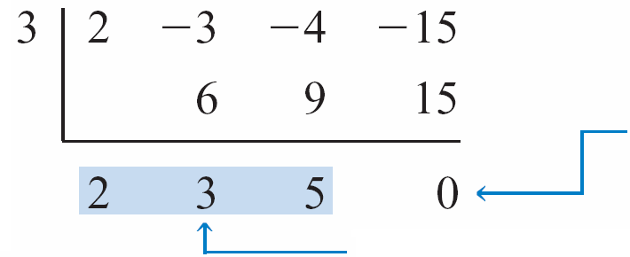
Example 5 – Find a Reduced Polynomial
Verify that (x – 3) is a factor of P(x) = 2x³ – 3x² – 4x – 15,
and write P(x) as the product of (x – 3) and the reduced
polynomial Q(x).
Solution:
This 0 indicates that (x – 3)
is a factor of P(x).
Coefficients of the
reduced polynomial Q(x)

Slide 40
Example 5 – Solution
Thus (x – 3) and the reduced polynomial 2x² + 3x + 5 are both factors of P. That is,
P(x) = 2x³ – 3x² – 4x – 15
= (x – 3)(2x² + 3x + 5)

Slide 41
SECTION 3.2
POLYNOMIAL FUNCTIONS OF HIGHER DEGREE

Slide 42
Polynomial Functions of Higher Degree
Table 3.1 summarizes information about graphs of polynomial functions of degree 0, 1, or 2.
In this section, we will focus on polynomial functions of degree 3 or higher.
Table 3.1

Slide 43
Polynomial Functions of Higher Degree
These functions can be graphed by the technique of plotting points; however, some additional knowledge about polynomial functions will make graphing easier.
All polynomial functions have graphs that are smooth continuous curves.
The terms smooth and continuous are defined rigorously in calculus, but for the present, a smooth curve is a curve that does not have sharp corners, like the graph shown in Figure 3.5a.
Continuous, but not smooth
Figure 3.5(a)

Slide 44
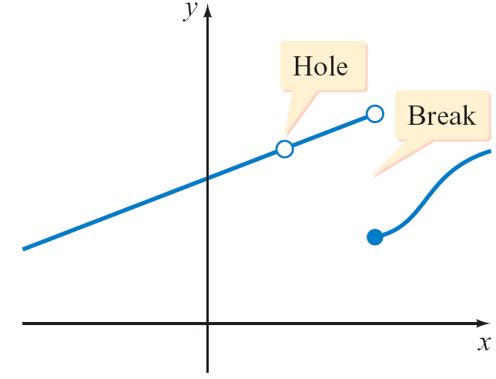
Polynomial Functions of Higher Degree
A continuous curve does not have a break or hole, like the
graph shown in Figure 3.5b.
Note
The general form of a polynomial is given by
a_{n}x^{n} + a_{n – 1}x^{n – 1} + . . . a₂x² +a₁x + a₀
The coefficients a_{n}, a_{n – 1}, . . . , a₂, a₁, a₀ are
all real numbers unless specifically
stated otherwise.
Not continuous
Figure 3.5(b)

Slide 45
FAR-LEFT AND FAR-RIGHT BEHAVIOR
(END BEHAVIOUR OF POLYNOMIALS)

Slide 46
Far-Left and Far-Right Behavior (End Behavior) OF POLYNOMIAL
The end behavior of a polynomial is a description of what happens as x becomes large in positive or negative direction.
For any polynomial, the end behavior is determined by the term that contains the highest power of x (leading term), because when x is large, the other terms are relatively insignificant in size.
The end behavior of the polynomial
P(x) = a_{n}x^{n} + a_{n – 1}x^{n – 1} + . . . a₂x² +a₁x + a₀
Is determined by the degree n and the sign of the leading coefficient a_{n} .

Slide 47
Far-Left and Far-Right Behavior
Note
The leading term of a polynomial function in x is the nonzero term that contains the largest power of x. The leading coefficient of a polynomial function is the coefficient of the leading term.

Slide 48
The following graphs shows the far-left and far-right behavior of a polynomial function P with leading term a_{n}x^{n}.

Slide 49

Example 1 – Determine the Far-Left and Far-Right Behavior of a Polynomial Function
Examine the leading term to determine the far-left and far-right behavior of the graph of each polynomial function.
a. P(x) = x³ – x b. S(x) = x⁴ – x² + 2
c. T(x) = –2x³ + x² + 7x – 6 d. U(x) = 9 + 8x² – x⁴

Slide 50
Example 1(a) – Solution
Because a_{n} = 1 is positive and n = 3 is odd, the graph of P goes down to the far left and up to the far right.
See the figure below.
Figure

Slide 51
Example 1(b) – Solution
cont’d
Because a_{n} = is positive and n = 4 is even, the graph of S goes up to the far left and up to the far right.
See the figure below.
Figure

Slide 52
Example 1(c) – Solution
cont’d
Because a_{n} = –2 is negative and n = 3 is odd, the graph of T goes up to the far left and down to the far right.
See the figure .
Figure

Slide 53
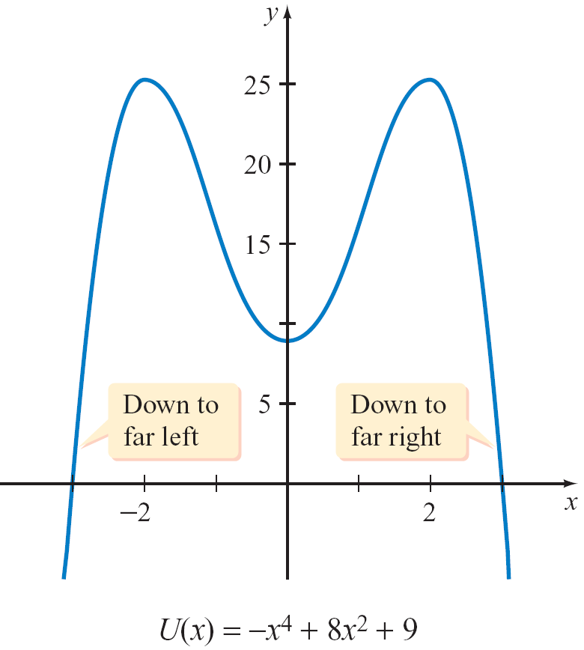
Example 1(d) – Solution
cont’d
The leading term of U is –x⁴ and the leading coefficient is –1.
Because a_{n} = –1 is negative
and n = 4 is even, the graph
of U goes down to the far left
and down to the far right.
See the figure below.
Figure

Slide 54
ZEROS OF A POLYNOMIAL FUNCTION

Slide 55
REAL ZEROS OF A POLYNOMIAL FUNCTION

Slide 56
Real Zeros of a Polynomial Function
Sometimes the real zeros of a polynomial function can be determined by using the factoring procedures.
We illustrate this concept in the next example.

Slide 57
Example 3 – Factor to Find the Real Zeros of a Polynomial Function
Factor to find the three real zeros of P(x) = x³ + 3x² – 4x.
Solution:
P can be factored as shown below.
P(x) = x³ + 3x² – 4x
= x(x² + 3x – 4)
= x(x – 1)(x + 4)
The real zeros of P(x) are x = 0, x = 1, and x = –4.
Factor out the common factor x.
Factor the trinomial x² + 3x – 4.

Slide 58
Example 3 – Solution
cont’d
The graph of P has x-intercepts at (0, 0), (1, 0), and (–4, 0).

Slide 59
REAL ZEROS, X-INTERCEPTS, AND FACTORS OF A POLYNOMIAL FUNCTION

Slide 60
Real Zeros, x-Intercepts, and Factors of a Polynomial Function
The following theorem summarizes important relationships among the real zeros of a polynomial function, the x-intercepts of its graph, and its factors; this theorem can be written in the form (x – c), where c is a real number.

Slide 61
Polynomial Functions, Real Zeros, Graphs, and Factors (x – c)
If P is a polynomial function and c is a real number, then all of the following statements are equivalent in the following sense: If any one statement is true, then they are all true, and if any one statement is false, then they are all false.
(x – c) is a factor of P.
x = c is a real solution of P(x) = 0.
x = c is a real zero of P.
(c, 0) is an x-intercept of the graph of y = P(x).

Slide 62
Real Zeros, x-Intercepts, and Factors of a Polynomial Function
Sometimes it is possible to make use of the preceding theorem and a graph of a polynomial function to find factors of the function. For example, the graph of
S(x) = x³ – 2x² – 5x + 6
is shown in Figure 3.15.
The x-intercepts are (–2, 0), (1, 0),
and (3, 0). Hence –2, 1, and 3 are
zeros of S, and [x – (–2)], (x – 1),
and (x – 3) are all factors of S.
Figure 3.15

Slide 63
EVEN AND ODD POWERS OF (X – C) THEOREM

Slide 64
Even and Odd Powers of (x – c) Theorem
Use a graphing utility to graph P(x) = (x + 3)(x – 4)².
Compare your graph with Figure 3.16.
Examine the graph near the x-intercepts (–3, 0) and (4, 0).
Figure 3.16

Slide 65
Even and Odd Powers of (x – c) Theorem
Observe that the graph of P
crosses the x-axis at (–3, 0).
intersects but does not cross the x-axis at (4, 0).
The following theorem can be used to determine at which x-intercepts the graph of a polynomial function will cross the x-axis and at which x-intercepts the graph will intersect but not cross the x-axis.

Slide 66
Even and Odd Powers of (x – c) Theorem
Even and Odd Powers of (x – c) Theorem
If c is a real number and the polynomial function P has (x – c) as a factor exactly k times, then the graph of P will intersect but
NOT cross the x-axis at (c, 0), provided k is an even positive integer.
cross the x-axis at (c, 0), provided k is an odd positive integer.

Slide 67
Example 5 – Apply the Even and Odd Powers of (x – c) Theorem
Determine where the graph of P(x) = (x + 3)(x – 2)²(x – 4)³ crosses the x-axis and where the graph intersects but does not cross the x-axis.
Solution:
The exponents of the factors (x + 3) and (x – 4) are odd integers. Therefore, the graph of P will cross the x-axis at the x-intercepts (–3, 0) and (4, 0).
The exponent of the factor (x – 2) is an even integer. Therefore, the graph of P will intersect but not cross the x-axis at (2, 0).

Slide 68
PROCEDURE FOR GRAPHING POLYNOMIAL FUNCTIONS

Slide 69
Procedure for Graphing Polynomial Functions
You may find that you can sketch the graph of a polynomial function just by plotting several points; however, the following procedure will help you sketch the graph of many polynomial functions in an efficient manner.
Procedure for Graphing Polynomial Functions
P(x) = a_{n}x^{n} + a_{n – 1}x^{n – 1} + . . . + a₁x + a₀, a_{n} ≠ 0
To graph P, follow these steps.
1. Determine the far-left and far-right behavior: Examine the leading coefficient a_{n}x^{n} to determine the far-left and far-right behavior of the graph.

Slide 70
Procedure for Graphing Polynomial Functions
2. Find the y-intercept: Determine the y-intercept by evaluating P(0).
Find the x-intercept/s and determine the behavior of the graph near the x-intercept/s:
If possible, find the x-intercepts by factoring. If (x – c), where c is a real number, is a factor of P, then (c, 0) is an x-intercept of the graph.
Use the Even and Odd Powers of (x – c) Theorem to determine where the graph crosses the x-axis and where the graph intersects but does not cross the x-axis.

Slide 71
Procedure for Graphing Polynomial Functions
4. Find additional points on the graph: Find a few additional points (in addition to the intercepts).
5. Check for symmetry:
a. The graph of an even function is symmetric with respect to the y-axis.
b. The graph of an odd function is symmetric with respect to the origin.

Slide 72
Procedure for Graphing Polynomial Functions
6. Sketch the graph: Use all the information previously obtained to sketch the graph of the polynomial function. The graph should be a smooth continuous curve that passes through the points determined in steps 2 through 4. The graph should have a maximum of n – 1 turning points.

Slide 73
Example 6 – Graph a Polynomial Function
Sketch the graph of P(x) = x³ – 4x² + 4x.
Solution:
1. Determine the far-left and far-right behavior: The leading term is 1x³. Because the leading coefficient, 1, is positive and the degree of the polynomial, 3, is odd, the graph of P goes down to the far left and up to the far right.
2. Find the y-intercept: P(0) = 0³ – 4(0)² + 4(0) = 0. The y-intercept is (0, 0).

Slide 74
cont’d
3. Find the x-intercept or x-intercepts and determine the behavior of the graph near the x-intercept or x-intercepts: Try to factor x³ – 4x² + 4x.
x³ – 4x² + 4x = x(x² – 4x + 4)
= x(x – 2)(x – 2)
= x(x – 2)²
Because (x – 2) is a factor of P, the point (2, 0) is an x-intercept of the graph of P. Because x is a factor of P (think of x as x – 0), the point (0, 0) is an x-intercept of the graph of P.

Slide 75
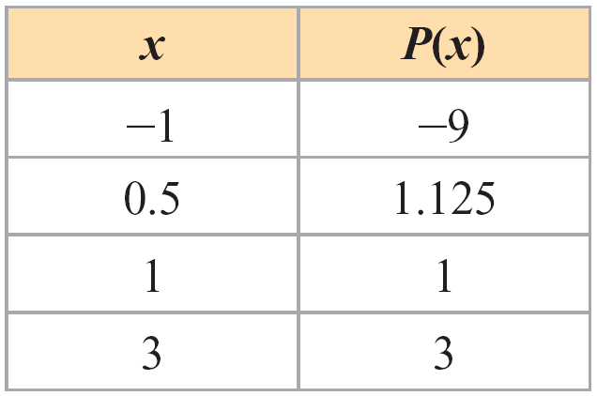
cont’d
Applying the Even and Odd Powers of (x – c) Theorem allows us to determine that the graph of P crosses the x-axis at (0, 0) and intersects but does not cross the x-axis at (2, 0).
4. Find additional points on the graph:

Slide 76
cont’d
5. Check for symmetry: The function P is neither an even nor an odd function, so the graph of P is not symmetric to either the y-axis or the origin.
6. Sketch the graph: See Figure 3.17.
Figure 3.17

Slide 77
MULTIPLE ZEROS OF A POLYNOMIAL FUNCTION

Slide 78
MULTIPLE ZEROS OF A POLYNOMIAL FUNCTION
Recall that if P is a polynomial function then the values of x for which P(x) is equal to 0 are called the zeros of P or the roots of the equation P(x) = 0.
A zero of a polynomial function may be a multiple zero.
For example, P(x) = x² + 6x + 9 can be expressed in factored form as (x + 3)(x + 3).
Setting each factor equal to zero yields x = –3 in both cases.

Slide 79
Multiple Zeros of a Polynomial Function
Thus P(x) = x² + 6x + 9 has a zero of –3 that occurs twice.
The following definition will be most useful when we are discussing multiple zeros.
Definition of Multiple Zeros of a Polynomial Function
If a polynomial function P has (x – r ) as a factor exactly k times, then r is a zero of multiplicity k of the polynomial function P.

Slide 80
Multiple Zeros of a Polynomial Function
Example
The graph of the polynomial function
P(x) = (x – 5)²(x + 2)³(x + 4)
is shown in the figure.
P(x) = (x – 5)²(x + 2)³(x + 4)

Slide 81
MULTIPLE ZEROS OF A POLYNOMIAL FUNCTION
5 as a zero of multiplicity 2.
–2 as a zero of multiplicity 3.
– 4 as a zero of multiplicity 1.
A zero of multiplicity 1 is generally referred to as a simple zero.
When searching for the zeros of a polynomial function, it is important that we know how many zeros to expect. For the work in this section, the following result is valuable.
This polynomial function has

Slide 82
Multiple Zeros of a Polynomial Function
Number of Zeros of a Polynomial Function
A polynomial function P of degree n has at most n zeros, where each zero of multiplicity k is counted k times.

Slide 83
RATIONAL ZERO THEOREM

Slide 84
Rational Zero Theorem
The factor theorem tells us that finding zeros of a polynomial is really the same as factoring it into linear factors.
To understand the next theorem, let’s consider the polynomial
P(x)= (x-2) (x-3) (x+4) ---- Factored form
P(x) = x³ – x² – 14x+24 ---- Expanded form
From the factored form we see that the zeros of P are 2,3 and -4. When the polynomial is expanded, the constant 24 is obtained by multiplying 2,3,-4. This means that the zeros of the polynomial are all factors of the constant term 24. The following generalizes this observation.

Slide 85
Rational Zero Theorem
The rational zeros of polynomial functions with integer coefficients can be found with the aid of the following theorem.
Rational Zero Theorem
If the polynomial P(x) = a_{n}x^{n} + a_{n – 1}x^{n} – ¹ + . . . + a₁x + a₀ has integer coefficients (a_{n} ≠ 0) , then every rational zero of P is of the form
( in simplest form).
Where p is a factor of the constant term a₀
and q is a factor of the leading coefficient a_{n}.

Slide 86
Rational Zero Theorem
The Rational Zero Theorem often is used to make a list of
all possible rational zeros of a polynomial function.
The list consists of all rational numbers of the form ,
where p is an integer factor of the constant term a₀
and q is an integer factor of the leading coefficient a_{n}.

Slide 87
Example 1 – Apply the Rational Zero Theorem
Use the Rational Zero Theorem to list all possible rational zeros of P(x) = 4x⁴ + x³ – 40x² + 38x + 12
Solution:
List all integers p that are factors of 12 and all integers q that are factors of 4.
p: ±1, ±2, ±3, ±4, ±6, ±12
q: ±1, ±2, ±4
Form all possible rational numbers using ±1, ±2, ±3, ±4, ±6, and ±12 for the numerator and ±1, ±2, and ±4 for the denominator.

Slide 88
Example 1 – Solution
cont’d
By the Rational Zero Theorem, the possible rational zeros are
It is not necessary to list a factor that is already listed in reduced form.
For example, is not listed because it is equal to

Slide 89
See examples from paper

Slide 90
DESCARTES’ RULE OF SIGNS

Slide 91
Descartes’ Rule of Signs
Descartes’ Rule of Signs is helpful in eliminating candidates from lengthy list of possible rational roots.
Descartes’ Rule of Signs states that the number of positive real roots of f(x) = 0 is equal to the number of variation in sign of f(x) or less than this by an even integer.
While the number of negative real roots is equal to the number of variation in sign of f(-x) or less than this by an even integer.
The terms are assumed to appear in order of descending powers of x.

Slide 92
EXAMPLE:
Possible roots:
+ | 2 | 0 | 2 | 0
- | 2 | 2 | 0 | 0
ί | 0 | 2 | 2 | 4

Slide 93
EXAMPLE:
Possible roots:
+ | 1 | 1
- | 3 | 1
ί | 2 | 4

Slide 94
Descartes’ Rule of Signs
For example, the polynomial function
P(x) = +3x⁴ – 5x³ – 7x² + x – 7
has three variations in sign.
The polynomial function
P(–x) = +3(–x)⁴ – 5(–x)³ – 7(–x)² + (–x) – 7
= + 3x⁴ + 5x³ – 7x² – x – 7
has one variation in sign.

Slide 95
Descartes’ Rule of Signs
Terms that have a coefficient of 0 are not counted as variations in sign and may be ignored. For example,
P(x) = –x⁵ + 4x² + 1
has one variation in sign.

Slide 96

Example 3 – Apply Descartes’ Rule of Signs
Use Descartes’ Rule of Signs to determine both the number of possible positive and the number of possible negative real zeros of each polynomial function.
a. P(x) = x⁴ – 5x³ + 5x² + 5x – 6
b. P(x) = 2x⁵ + 3x³ + 5x² + 8x + 7
Solution:
a. P(x) = +x⁴ – 5x³ + 5x² + 5x – 6
There are three variations in sign. By Descartes’ Rule of Signs, there are either three or one positive real zeros.

Slide 97
Example 3 – Solution
cont’d
Now examine the variations in sign of P(–x).
P(–x) = x⁴ + 5x³ + 5x² – 5x – 6
There is one variation in sign of P(–x). By Descartes’ Rule of Signs, there is one negative real zero.

Slide 98
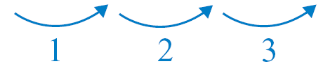
Example 3 – Solution
cont’d
b. P(x) = 2x⁵ + 3x³ + 5x² + 8x + 7 has no variations in sign, so there are no positive real zeros.
P(–x) = –2x⁵ – 3x³ + 5x² – 8x + 7
P(–x) has three variations in sign, so there are either three or one negative real zeros.

Slide 99
Descartes’ Rule of Signs
In applying Descartes’ Rule of Signs, we count each zero of multiplicity k as k zeros. For instance,
P(x) = x² – 10x + 25
has two variations in sign.
Thus, by Descartes’ Rule of Signs, P must have either two or no positive real zeros. Factoring P produces (x – 5)², from which we can observe that 5 is a positive zero of multiplicity 2.

Slide 100
UPPER AND LOWER BOUNDS FOR REAL ZEROS

Slide 101
THEOREM ON BOUNDS
The Theorem on Bounds states that if f(x) is divided by x-r and the terms of the quotient are either all positive or all negative then r is an upper bound of the roots.
However, if f(x) is divided by x-r and the terms of the quotient alternate in signs then r is a lower bound of the roots.
Examples:

Slide 102
Upper and Lower Bounds for Real Zeros
A real number b is called an upper bound of the zeros of the polynomial function P if no zero is greater than b.
A real number b is called a lower bound of the zeros of P if no zero is less than b.

Slide 103
Upper and Lower Bounds for Real Zeros
Upper and lower bounds are not unique.
For example, if b is an upper bound for the real zeros of P, then any number greater than b is also an upper bound.
Likewise, if a is a lower bound for the real zeros of P, then any number less than a is also a lower bound.

Slide 104
Example 2 – Find Upper and Lower Bounds
According to the Upper- and Lower-Bound Theorem, what is the smallest positive integer that is an upper bound and the largest negative integer that is a lower bound of the real zeros of
P(x) = 2x³ + 7x² – 4x – 14?
Solution:
To find the smallest positive-integer upper bound, use synthetic division with 1, 2, . . . , as test values.
No negative numbers

Slide 105
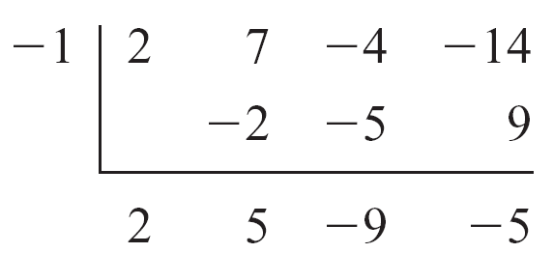
Example
cont’d
According to the Upper- and Lower-Bound Theorem, 2 is the smallest positive-integer upper bound.
Now find the largest negative-integer lower bound.
According to the Upper- and Lower-Bound Theorem, –4 is the largest negative-integer lower bound.
Alternating signs

Slide 106
Example 2 – Find Upper and Lower Bounds
According to the Upper- and Lower-Bound Theorem, what is the smallest positive integer that is an upper bound and the largest negative integer that is a lower bound of the real zeros of
P(x) = 2x³ + 7x² – 4x – 14?
Solution:
To find the smallest positive-integer upper bound, use synthetic division with 1, 2, . . . , as test values.
No negative numbers

Slide 107
Example 2 – Solution
cont’d
According to the Upper- and Lower-Bound Theorem, 2 is the smallest positive-integer upper bound.
Now find the largest negative-integer lower bound.
According to the Upper- and Lower-Bound Theorem, –4 is the largest negative-integer lower bound.
Alternating signs

Slide 108
Zeros of a Polynomial Function

Slide 109
Zeros of a Polynomial Function
Guidelines for Finding the Zeros of a Polynomial Function with Integer Coefficients
1. Gather general information Determine the degree n of the polynomial function. The number of distinct zeros of the polynomial function is at most n. Apply Descartes’ Rule of Signs to find the possible number of positive zeros and possible number of negative zeros.
2. Check suspects Apply the Rational Zero Theorem to list rational numbers that are possible zeros. Use synthetic division to test numbers in your list. If you find an upper or a lower bound, then eliminate from your list any number that is greater than the upper bound or less than the lower bound.

Slide 110
Zeros of a Polynomial Function
3. Work with the reduced polynomials Each time a zero is found, you obtain a reduced polynomial.
If a reduced polynomial is of degree 2, find its zeros either by factoring or by applying the quadratic formula.
If the degree of a reduced polynomial is 3 or greater, repeat the preceding steps for this polynomial.
Example 4 illustrates the procedure discussed in the preceding guidelines.

Slide 111
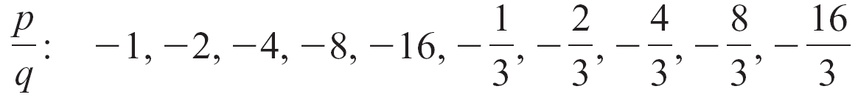
Example 4 – Find the Zeros of a Polynomial Function
Find the zeros of P(x) = 3x⁴ + 23x³ + 56x² + 52x + 16.
Solution:
1. Gather general information: The degree of P is 4. Thus the number of zeros of P is at most 4. By Descartes’ Rule of Signs, there are no positive zeros and there are four, two, or no negative zeros.
2. Check suspects: By the Rational Zero Theorem, the
possible negative rational zeros of P are

Slide 112
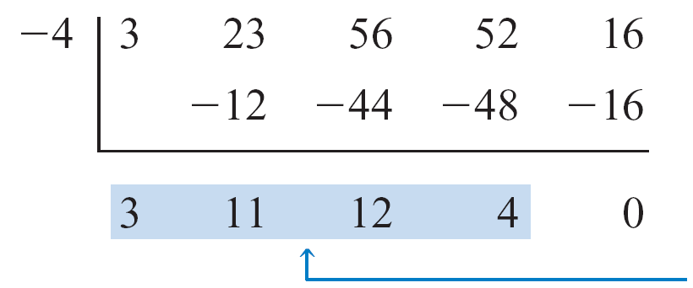
Example 4 – Solution
cont’d
Use synthetic division to test the possible rational zeros. The following work shows that – 4 is a zero of P.
3. Work with the reduced polynomials: Because – 4 is a zero, (x + 4) and the first reduced polynomial (3x³ + 11x² + 12x + 4) are both factors of P.
Thus
P(x) = (x + 4)(3x³ + 11x² + 12x + 4)
Coefficients of the first
reduced polynomial

Slide 113
Example 4 – Solution
cont’d
All remaining zeros of P must be zeros of 3x³ + 11x² + 12x + 4.
The Rational Zero Theorem indicates that the only possible negative rational zeros of 3x³ + 11x² + 12x + 4 are
Synthetic division is again used to test possible zeros.
Coefficients of the second
reduced polynomial

Slide 114
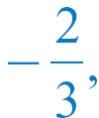
Example 4 – Solution
cont’d
Because –2 is a zero, (x + 2) is also a factor of P.
Thus P(x) = (x + 4)(x + 2)(3x² + 5x + 2)
The remaining zeros of P must be zeros of 3x² + 5x + 2.
3x² + 5x + 2 = 0
(3x + 2)(x + 1) = 0
x = and x = –1
The zeros of P(x) = 3x⁴ + 23x³ + 56x² + 52x + 16 are
–4, –2, and –1.

Slide 115


Slide 116
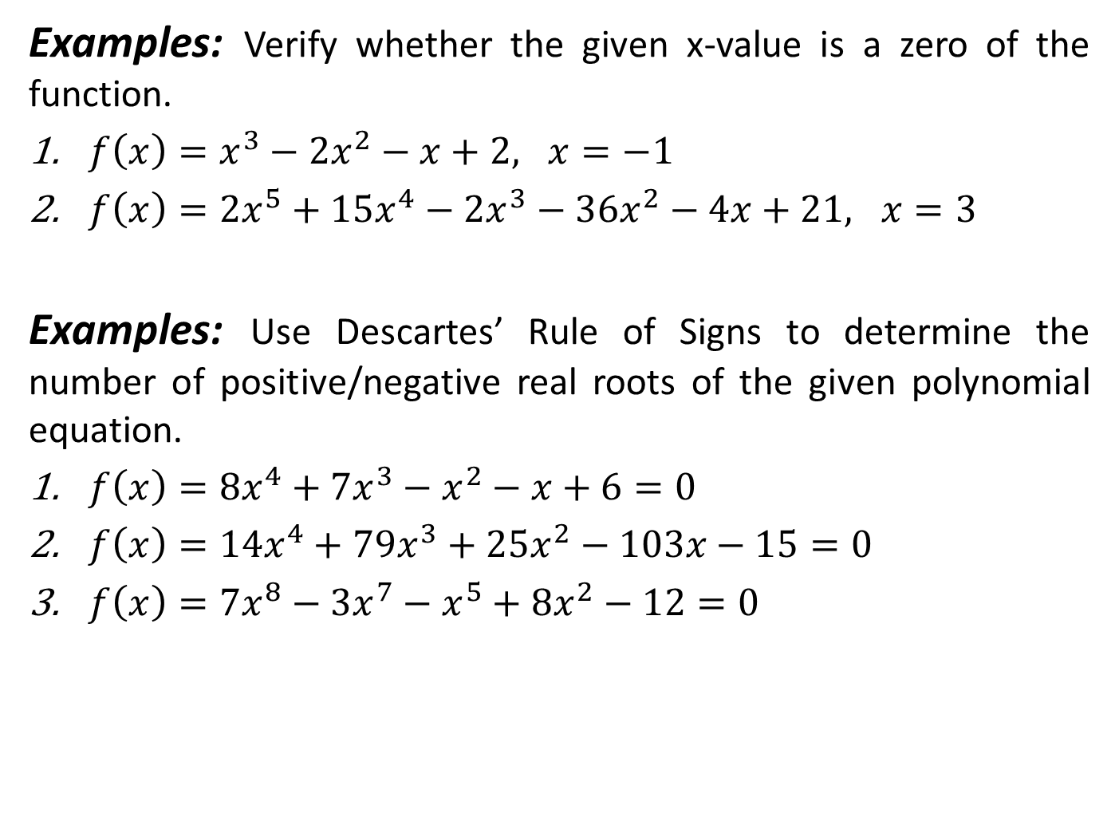

Slide 117
FUNDAMENTAL THEOREM OF ALGEBRA
The Fundamental Theorem of Algebra states that every polynomial equation has at least one root, which may be a real or a complex number.
2. If f(x) is of degree n, then there will be n linear factors.
3. Every polynomial equation of degree n has exactly n roots.
4. Complex roots always occur in conjugate pairs, a+bi and a-bi.
If the coefficients of the equation
F(x)= = 0
are integers, then any rational roots are factors of a₀ / a_{n}.

Slide 118
Example 1 – Find the Zeros and Linear Factors of a Polynomial Function
Find all the zeros of each of the following polynomial
functions, and write each function as a product of its
leading coefficient and its linear factors.
a. P(x) = x⁴ – 4x³ + 8x² – 16x + 16
b. S(x) = 2x⁴ + x³ + 39x² + 136x – 78

Slide 119
Solution
a. By the Linear Factor Theorem, P will have four linear factors and thus four zeros.
The possible rational zeros are ±1, ±2, ±4, ±8, and ±16.
Use synthetic division to show that 2 is a zero of multiplicity 2.

Slide 120
Example 1 – Solution
a. By the Linear Factor Theorem, P will have four linear factors and thus four zeros.
The possible rational zeros are ±1, ±2, ±4, ±8, and ±16.
Use synthetic division to show that 2 is a zero of multiplicity 2.

Slide 121

example 1 – solution
cont’d
the final reduced polynomial is x² + 4.
solve x² + 4 = 0 to find the remaining zeros.
x² + 4 = 0
x² = –4
the four zeros of p are 2, 2, –2i, and 2i.

Slide 122
Example 1 – Solution
cont’d
The leading coefficient of P is 1.
Thus the linear factored form of P is
P(x) = 1(x – 2)(x – 2)(x – (–2i ))(x – 2i )
or, after simplifying,
P(x) = (x – 2)²(x + 2i )(x – 2i )

Slide 123

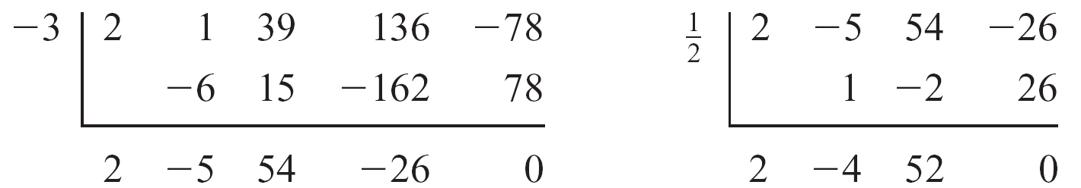
Example 1 – Solution
cont’d
b. By the Linear Factor Theorem, S will have four linear factors and thus four zeros.
The possible rational zeros are
Use synthetic division to show that –3 and are zeros of S.

Slide 124
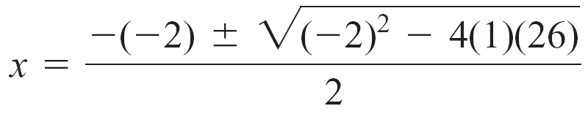
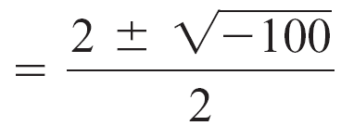
Example 1 – Solution
cont’d
The final reduced polynomial is 2x² – 4x + 52.
The remaining zeros can be found by using the quadratic formula to solve
2x² – 4x + 52 = 0
x² – 2x + 26 = 0
Divide each side by 2.

Slide 125
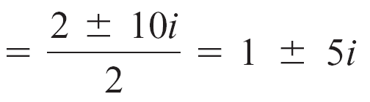

Example 1 – Solution
cont’d
The four zeros are –3, , 1 + 5i, and 1 – 5i.
The leading coefficient of S is 2.

Slide 126
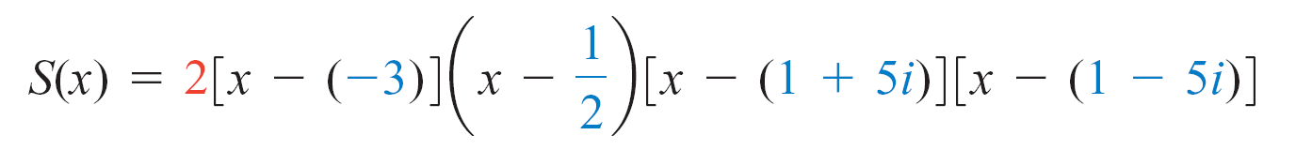
Example 1 – Solution
cont’d
Thus the linear factored form of S is
or, after simplifying,

Slide 127
Conjugate Pair Theorem

Slide 128
Conjugate Pair Theorem
You may have noticed that the complex zeros of the
polynomial function in Example 1 were complex
conjugates.
The following theorem shows that this is not a coincidence.
Conjugate Pair Theorem
If a + bi (b ≠ 0) is a complex zero of a polynomial function with real coefficients, then the conjugate a – bi is also a complex zero of the polynomial function.

Slide 129
Example 2 – Use the Conjugate Pair Theorem to Find Zeros
Find all the zeros of P(x) = x⁴ – 4x³ + 14x² – 36x + 45,
given that 2 + i is a zero.
Solution:
Because the coefficients are real numbers and 2 + i is a zero, the Conjugate Pair Theorem implies that 2 – i also must be a zero.

Slide 130
Example 2 – Solution
cont’d
Using synthetic division with 2 + i and 2 – i, we have
The coefficients of the
reduced polynomial
The coefficients of the next
reduced polynomial

Slide 131
Example 2 – Solution
cont’d
The resulting reduced polynomial is x² + 9, which has 3i and –3i as zeros.
Therefore, the four zeros of x⁴ – 4x³ + 14x² – 36x + 45 are 2 + i, 2 – i, 3i, and –3i.

Slide 132
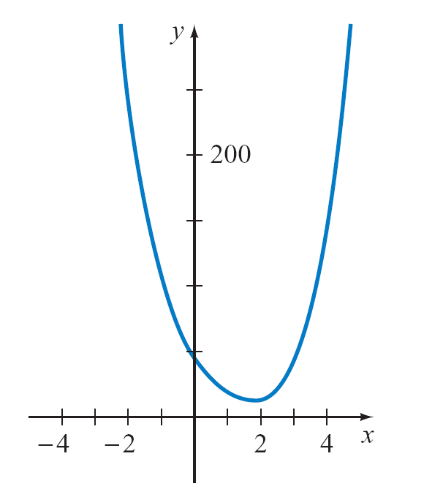
Conjugate Pair Theorem
A graph of P(x) = x⁴ – 4x³ + 14x² – 36x + 45 is shown in the figure below .
Because the polynomial in Example 2 is a fourth-degree polynomial and because we have verified that P has four non-real solutions, it comes as no surprise that the graph does not intersect the x-axis.
P(x) = x⁴ – 4x³ + 14x² – 36x + 45

Slide 133
Conjugate Pair Theorem
When performing synthetic division with complex numbers,
it is helpful to write the coefficients of the given polynomial
as complex coefficients.
For instance, –10 can be written as –10 + 0i.

Slide 134
Conjugate Pair Theorem
Recall that the real zeros of a polynomial function P are the
x-coordinates of the x-intercepts of the graph of P.
This important connection between the real zeros of a polynomial function and the x-intercepts of the graph of the polynomial function is the basis for using a graphing utility to solve equations.

Slide 135
Finding a Polynomial Function with Given Zeros

Slide 136
Finding a Polynomial Function with Given Zeros
Many of the problems in this section dealt with the process
of finding the zeros of a given polynomial function.
Example 5 considers the reverse process: finding a polynomial function when the zeros are given.

Slide 137
Example 5 – Determine a Polynomial Function Given Its Zeros
Find each polynomial function.
a. A polynomial function of degree 3 that has 1, 2, and –3 as zeros
b. A polynomial function of degree 4 that has real coefficients and zeros 2i and 3 – 7i
Solution:
a. Because 1, 2, and –3 are zeros, (x – 1), (x – 2),
and (x + 3) are factors.
The product of these factors produces a polynomial function with the indicated zeros.

Slide 138
Example 5 – Solution
cont’d
P(x) = (x – 1)(x – 2)(x + 3)
= (x² – 3x + 2)(x + 3)
= x³ – 7x + 6
b. By the Conjugate Pair Theorem, the polynomial function also must have –2i and 3 + 7i as zeros.
The product of the factors x – 2i, x – (–2i), x – (3 – 7i), and x – (3 + 7i) produces the desired polynomial function.

Slide 139
Example 5 – Solution
cont’d
P(x) = (x – 2i)(x + 2i)[x – (3 – 7i)][x – (3 + 7i)]
= (x² + 4)(x² – 6x + 58)
= x⁴ – 6x³ + 62x² – 24x + 232

Slide 140
Finding a Polynomial Function with Given Zeros
A polynomial function that has a given set of zeros is not unique.
For example, P(x) = x³ – 7x + 6 has zeros 1, 2, and –3, but so does any nonzero multiple of P, such as S(x) = 2x³ – 14x + 12.
This concept is illustrated in Figure 3.22.
The graphs of the two polynomial functions are different, but they have the same zeros.
Figure 3.22

